Slide 1

Meteorite Analysis
Final Project EDA and model

Slide 2
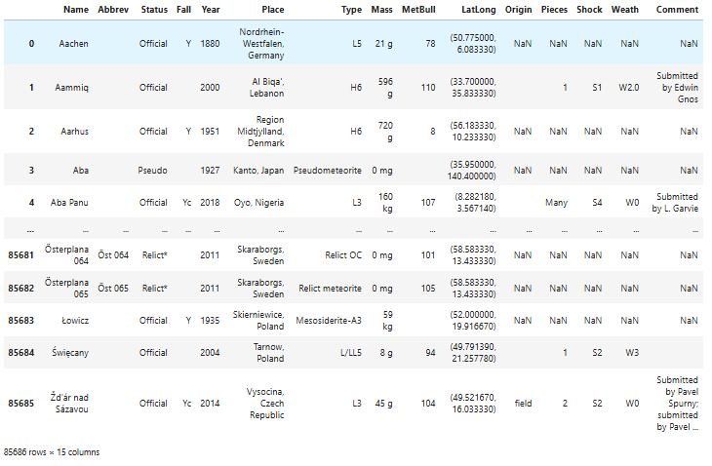
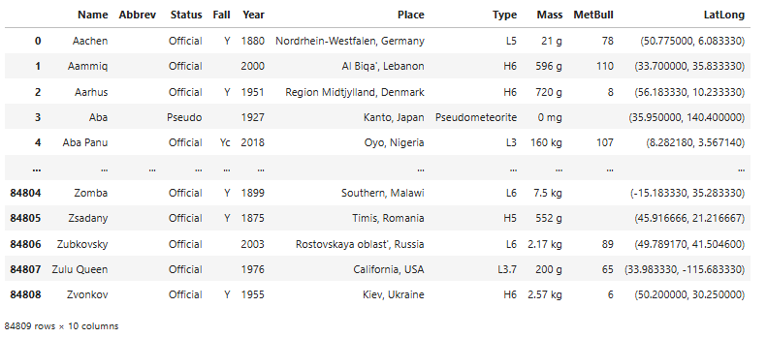
Data Collection
https://www.lpi.usra.edu/meteor/
Selecting “Normal” table
Selecting “Bulletin” table

Slide 3
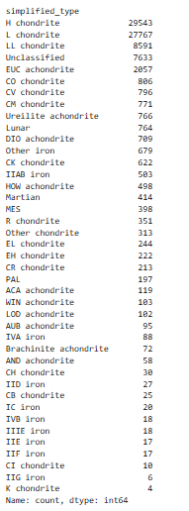
Data Cleaning
Simplifying meteorite type
Organizing mass to grams (g)
Cleaning Lat/Long coordinates
Dealing with Pieces, Shock, and Wealth

Slide 4
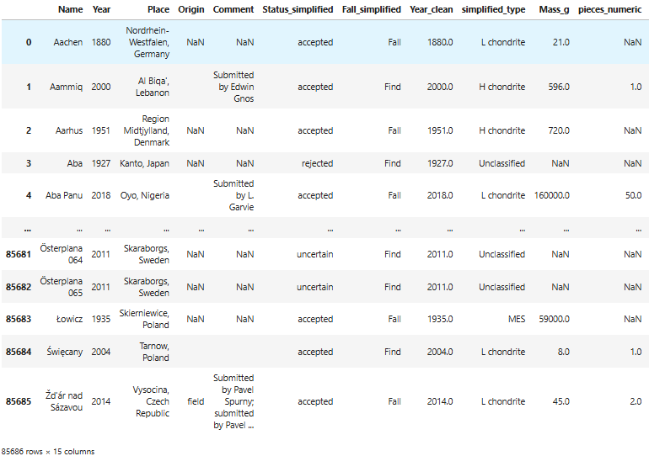
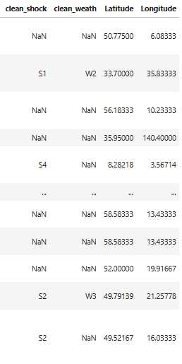
Data Cleaning

Slide 5
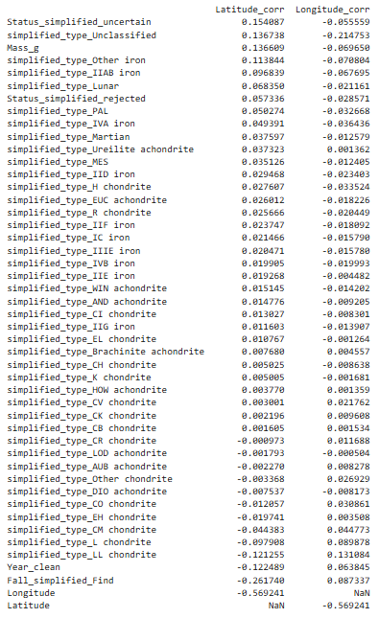

Feature Engineering
OneHotEncoder for categorical columns

Slide 6

Model Issues
The first model using Random Forest Regressor with multiple outputs (Lat/Long) did not work very well so a different approach was needed.

Slide 7
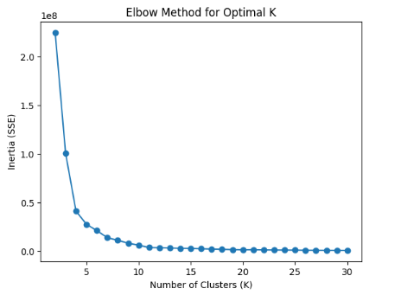
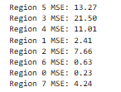
Predictive Models
Clustering with K-Means
Modeling with Random Forest Classifier
Using Regressor within clusters to predict Lat/Long Coordinates

Slide 8
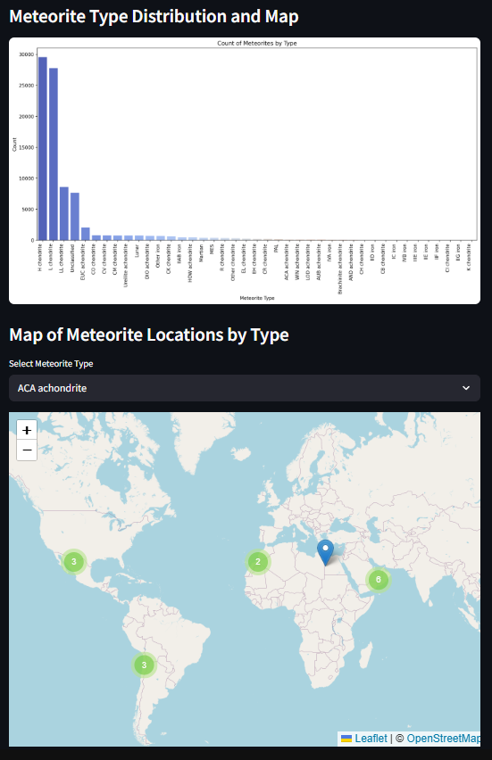
Visualizations
Interactable Maps
Imports use:
Matplotlib – General purpose plotter
Seaborn – Some visuals with more features
Folium – Active map that allows for zooming, panning, and other tools
Pydeck – Timeline slider

Slide 9
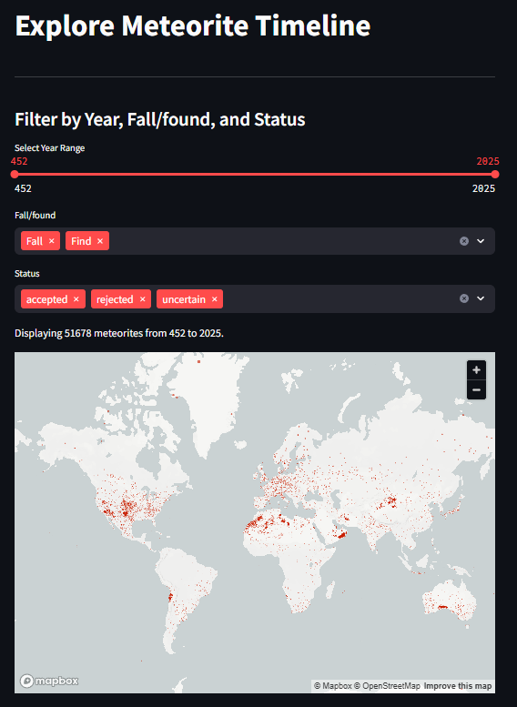
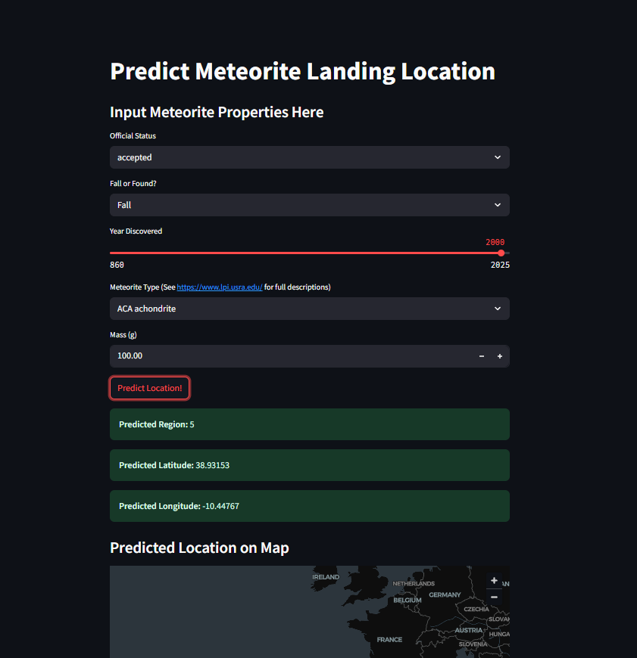
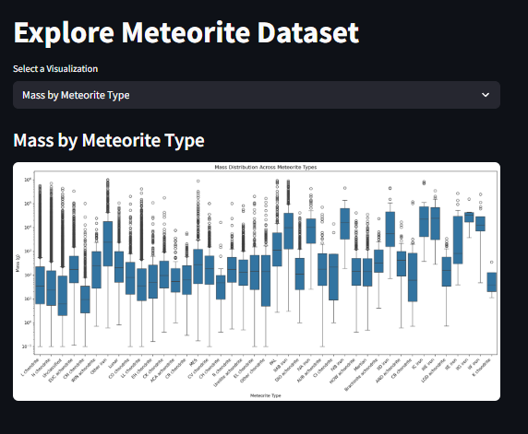
Deployment
Streamlit
Meteorite Prediction page
Explore Page
Timeline Page

Slide 10
Future Additions
Clean up predictive model more
Always room for improvement – different predictors, different feature weights
Narrow down clusters to produce better results
More static and interactable visualizations
Add a description to the meteorite types, what status means, ect

